Slide 1
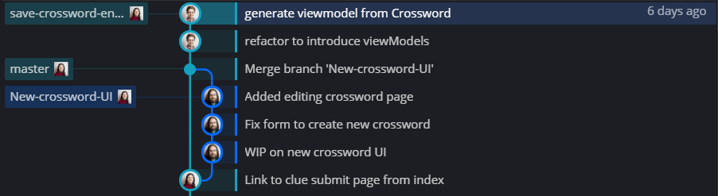
Part 2: Version Control In Git
Purpose of Git
Git is a version control system that allows you to track changes to your codebase over time, examine the differences between the current state of your codebase and the last known working version, as well as check out your codebase as it existed at various points in time:

Slide 2

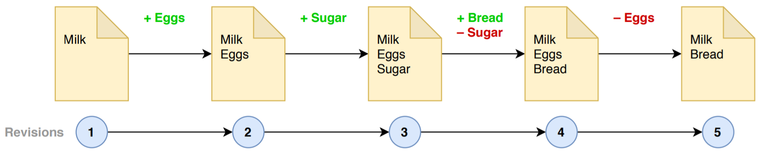
Commits
"Commits" are snapshots of your code that you've saved (like working on an important document and having copies called "My doc V1.docx", "My doc V2.docx", "My doc V3.docx", etc).
Every time you make a commit, you build on the previous one, making a chain of commits in a sort of timeline, retaining the ability to "time travel" to any point in time.

Slide 3
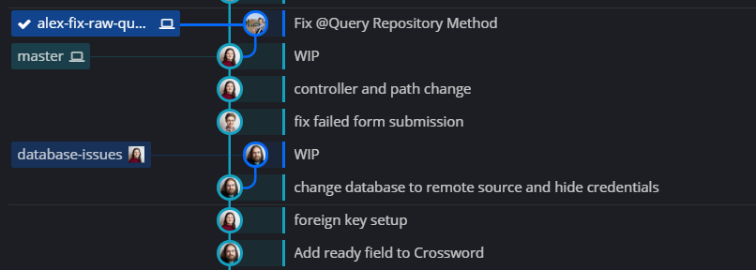
Branches
You can also make "Branches" - parallel universes in which your codebase looks slightly different. You can travel to different branches too.

Slide 4
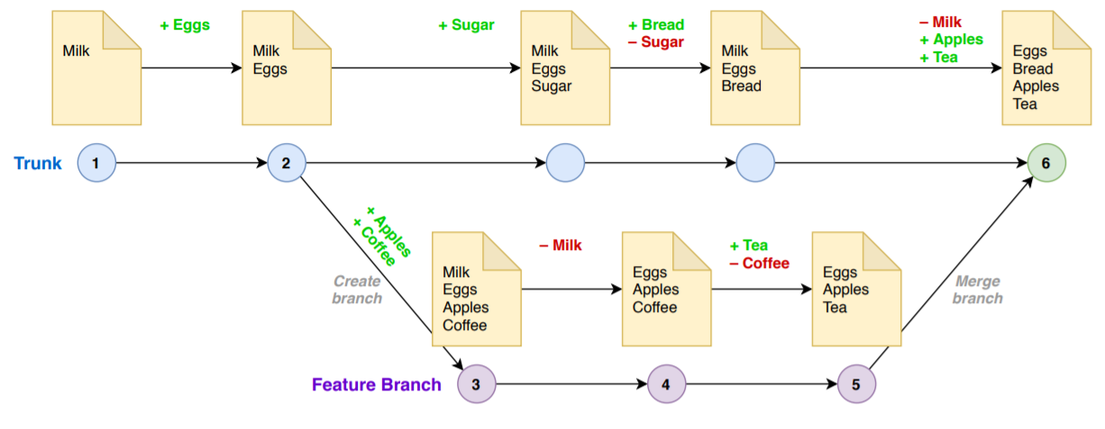
Merging Of Branches
Branches can be merged into each other (typically creating a “merge commit”)

Slide 5
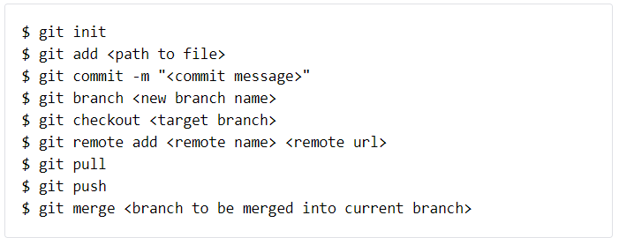
Basic Git Commands
Here is a summary of all the git commands you need to know about right now:

Slide 6
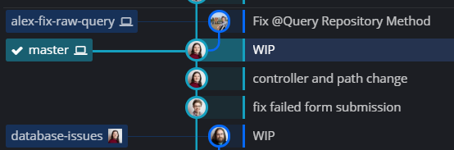
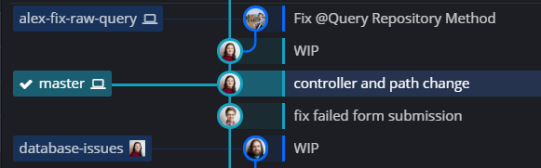
Part 2: New Concepts
Resetting
In Git, branches are merely a movable pointer/label on a commit. The label moves when you commit to that branch.
Resetting is a branch operation that moves the label directly:

Slide 7
Resetting (Continued)
The command for resetting is
A soft reset (--soft) will only move the position of branch label (meaning that git will now notice alot of changes)
Using a hard reset (--hard) will change all tracked files to match the new commit along with removing any new files that were added since.
The location is very flexible and you can even specify commits relative to the position of the current branch:

Slide 8
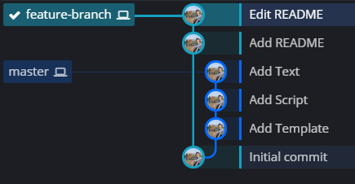
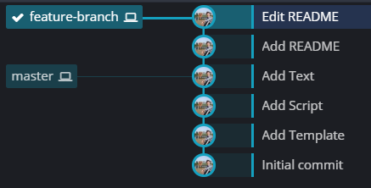
Rebasing Branches
Rebasing is where a branch’s commits are replayed on top of another branch. It can be considered an alternative to merging branches.
This can be useful for simplifying a repository’s commit history but does change that history permanently (so is not without risk).
The most common use for this is where you want to replay a feature branch on top of the latest state of the master branch:

Slide 9
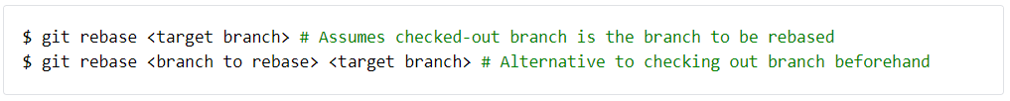
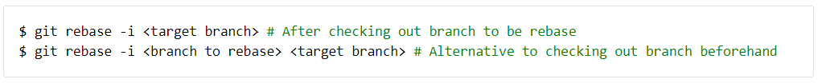
Rebasing Branches (Continued)
The command for rebasing is:
Interactive rebases provide customisation of how the branch’s commits should be replayed (typically an editor will open providing you with instructions on your customisation options):
Warning: Like merging, rebasing can lead to merge conflicts!

Slide 10
Part 2: Exercise
The Goal
Setting up a GitHub repository with your code from part 1.
You will:
Create a local repository, with some initial commits and branches
Create an online repository for your code and push up code from your local repository
(Extension) Create some pull requests for your repository
(Extension) Create (!) and resolve a merge conflict

Slide 11
Step 1
From the directory of your code from part 1, initialise a git repository and commit everything you have as an initial commit.
Add a readme file (called README.md) that describes how to use your code (in simple plaintext) and make a new commit with a message "Added README“
Add a text file with the name NewFile.txt to the directory of your local repository and create an appropriate commit.
Create a new branch called "reset", checkout this branch and then reset the branch to before the file in point b) was added (try a soft and then a hard reset)
Checkout master again, create a branch called "revert" and instead create a revert commit for the file addition (hint: use git revert)
Before moving to step 2, please allow your trainer to review the state of your git repository

Slide 12
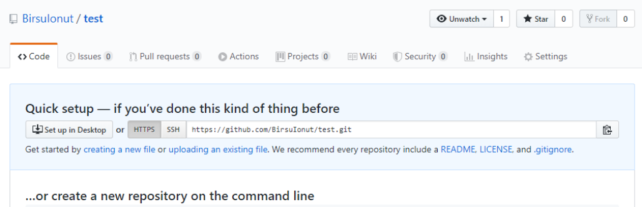
Step 2
Next, let's push up the code from parts 1 & 2 to a remote repository:
If you don't have an account already, create one on https://github.com/
You may want to create a personal one if you only have a work account
Download Git from https://git-scm.com/downloads
Create a new repository, giving it a name and leaving everything else untouched. You should now see this page:

Slide 13

Step 2 (continued)
Follow the instructions under "...or push an existing repository from the command line“
You will be prompted to provide your GitHub username and password in the terminal
If you prefer not to enter your credentials over a terminal you can create a SSH key to use with your GitHub account. This will involve running: And uploading the key to GitHub as described here (Ask a tutor if you want more details)
Refresh the page and now you should be able to see your pushed code. Please show the results to your tutor.

Slide 14

Step 3
Next, let's create a pull request:
Create a new branch (you can call it something like pow-operator)
Change the code from part 1 by adding a new operator, pow
Afterwards, make a commit and push the new branch to origin
On the repository page, go to branches and create a New pull request (you can also add a comment about the changes you made). For now, do not merge it.

Slide 15

Step 4
Finally, let’s resolve a merge conflict:
Checkout master and create a new branch, this time called mod-operator.
Change the code from part 1 by adding a new operator, mod. For the purposes of this exercise, you should have some overlapping work with the pow-operator branch (e.g. new work inside the same if-clauses, or adding functions at the end of the files, etc).
Make a commit and push the new branch to origin.

Slide 16
Step 4 (continued)
Merge the pow-operator branch (you can also safely delete the branch, as github will suggest you).
Create a new pull request, this time for mod-operator branch. This time though, you will get some warnings about some existing conflicts.
Go ahead and press Resolve conflicts button and resolve the conflicts GitHub couldn't solve on his own. For each file, when you finished, press Mark as resolved.
After resolving all the conflicts, commit merge and merge the branch into master.

